Slide 1
Convert from array to EF

Slide 2
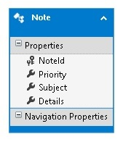
Now we will replace array fake data with EF storage
Delete the Note class def in Model folder and ref to using ProductsApp.Models;
Start SSMS and add a NotesDB new database to the mssqlserver2 instance (not the 3)
Leave SSMS open, as we will be back soon.
Add a new ADO.NET Entity Data Model, call it NoteModel
Choose the EMPTY EF Designer model
Add an entity and these props
SAVE it
Generate DB from model
SAVE it
int32

Slide 3
Now use db instead of array. Remove array def and 2 methods, add these:
NoteModelContainer myNotes = new NoteModelContainer();
// GET: Notes
public IEnumerable<Note> GetAllNotes()
{
return myNotes.Notes.ToList();
}
public IHttpActionResult GetNote(int id)
{
var oneNote = myNotes.Notes.FirstOrDefault((p) => p.NoteId == id);
if (oneNote == null)
{
return NotFound();
}
return Ok(oneNote);
}

Slide 4
debug

